Slide 1



THRYLOS
ADMIN MANAGEMENT PORTAL

Slide 2
OUR TEAM
THRYLOS ( 26E2109 )
ISHAN JHA
RASHMI JHA
UTSAV RATAN
VICKY JHA
PREM
VIVEK RAI
FACULTY MENTOR : SUMAN KUMAR DAS SIR

Slide 3
INTRODUCTION
Thrylos Admin Management Portal is a comprehensive web-based administrative system developed to manage and streamline operations of the Thrylos esports and organizational ecosystem.
The platform enables Super Admins and Admins to manage tournaments, employees, internships, analytics, attendance, payments, certifications, content work, and system logs from a centralized dashboard.

Slide 4
OBJECTIVES
To design a centralized admin dashboard for Thrylos.
To implement role-based authentication (Super Admin, Admin)
To manage esports players, tournaments, and revenue data.
To implement audit logging and activity tracking.
To integrate analytics and reporting systems.
To develop an internship and employee tracking system.

Slide 5
KEY FEATURES
Dashboard & Analytics
Certificate Management
Role-Based Access Control
Real-Time Modules
Players Management
System Control
Payment & Verification
Employee & Internship Management
Secure OTP Based Login

Slide 6
PROJECT USE CASE
Role | Main Function | Primary Modules
Super Admin | System Control | All Modules
Tech Admin | Technical Operations | Tech Dashboard, Logs
HR Admin | Workforce Management | Attendance, Leave, Internships
Esports Admin | Tournament & Player Management | Esports Dashboard
Content Admin | Media & Content | Content Dashboard
Social Admin | Social Growth & Analytics | Social Analytics

Slide 7
SYSTEM ARCHITECTURE
Layer | Component | Description
Client Layer | Web Application (React + TypeScript) | Provides the admin dashboard interface for all roles including Super Admin, Tech Admin, HR Admin, Esports Admin and all admins.
Communication Layer | HTTP / HTTPS API Requests | Enables secure communication between frontend and backend using RESTful APIs.
Application Layer | Backend Server (Node.js + Express) | Handles business logic, request processing, data validation, and module control.
Authentication & Security | JWT Authentication + Role-Based Middleware | Verifies user identity and restricts access based on assigned roles (RBAC system).
Database Layer | Supabase (PostgreSQL) | Stores users, admin roles, esports data, employee records, attendance, payments, analytics, and audit logs.
Real-Time Layer | Supabase Realtime / WebSockets | Enables live updates for notifications, chat, and dashboard activity tracking.
Storage Layer | Cloud Storage | Stores uploaded files, certificates, posters, media content, and documents.
Analytics Layer | Reporting & Data Processing Engine | Generates revenue reports, growth statistics, engagement tracking, and performance analytics.

Slide 8
DATA & RESOURCE
Category | Used In Project
User Data | Admin roles, employees, interns
Database | Supabase (PostgreSQL)
Frontend | React + TypeScript
Backend | Node.js + Express

Slide 9
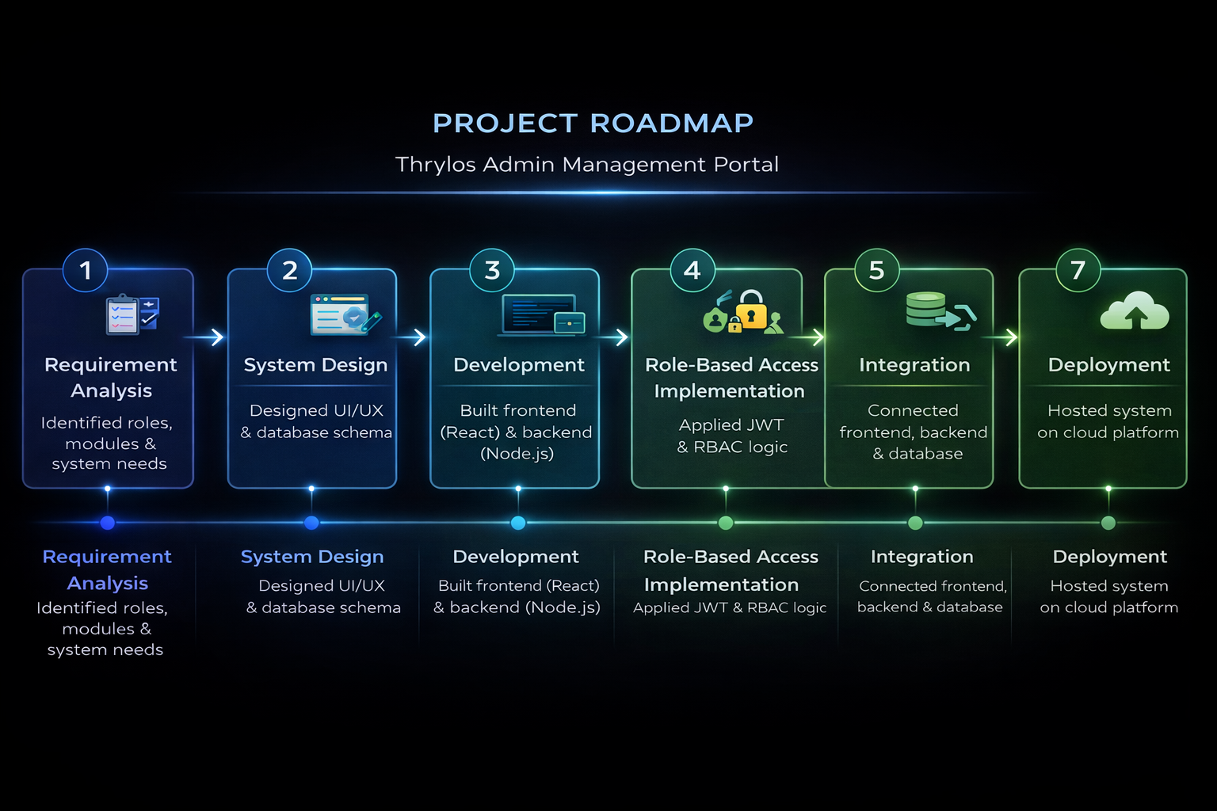
METHODOLOGY

Slide 10
EXPECTED RESULTS & IMPACT
RESULTS
IMPACTS
Fully functional admin control system
Real-time analytics dashboard
Improved operational efficiency
Reduced manual record keeping
Structured esports and HR management
Enables scalable esports management
Improves team productivity tracking
Provides centralized control over operations
Enhances transparency via audit logs
Data-driven growth monitoring

Slide 11
PROJECT TIMELINE
Phase | Description | Duration
Phase 1 | Requirement Gathering & Planning | 1 Week
Phase 2 | UI/UX Design & Architecture | 1 Week
Phase 3 | Backend & Database Setup | 2 Weeks
Phase 4 | Core Module Development | 2 Weeks
Phase 5 | Integration & Testing | 1 Week
Phase 6 | Optimization & Deployment | 1 Week

Slide 12
THANK YOU

